Slide 1

FoodSHIFT230
Introducing the
FoodSHIFT Accelerator Labs

Slide 2
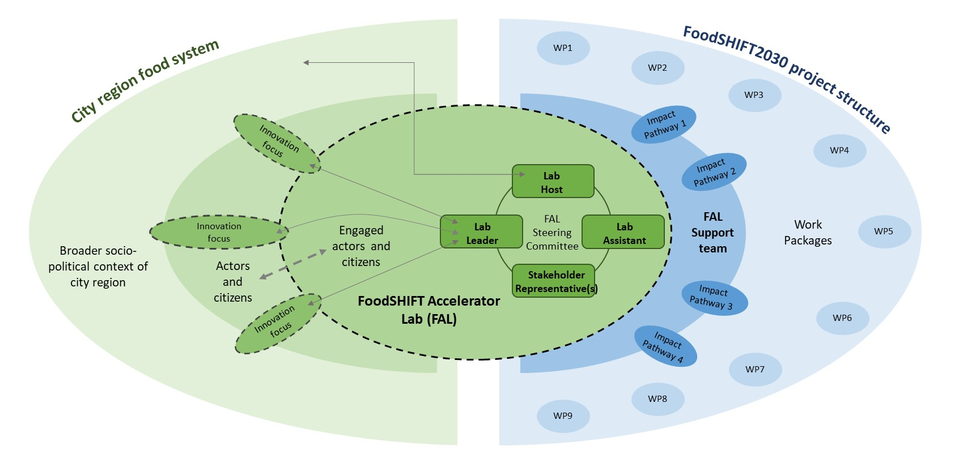
Positioning the LABs in the Region and the Project
WP 8 Project Management
FAL 1
WP 1
FAL 2
WP 3
FAL 3
WP 4
FAL 4
WP 5
FAL 5
WP 6
FAL 6
FAL 7
WP 7
FAL 8
WP 9
FAL9
WP 2

Slide 3
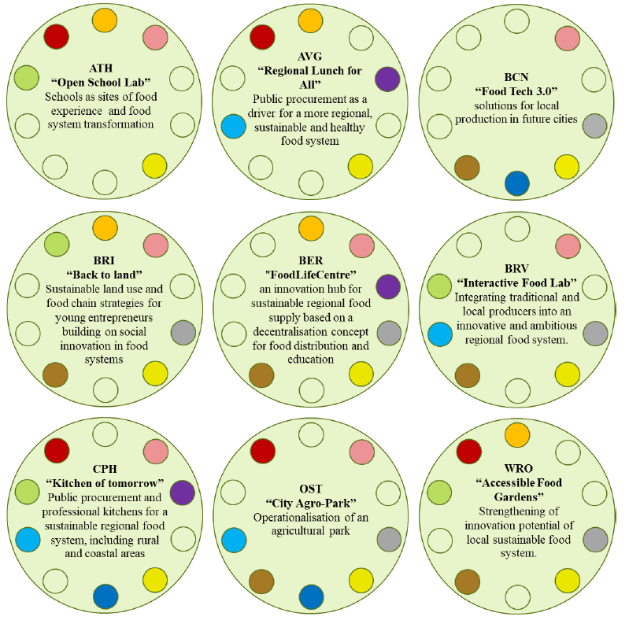
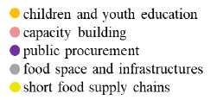
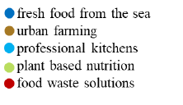
The Spatial Dimension: Ecological Footprint of Amsterdam

Slide 4
The Spatial Dimension: Ecological Footprint of Amsterdam
ATHENS
School gardens stopped,
for seniors / no supermarkets
AVIGNON
Central kitchen cooks now around 50% more meals for elderly people.
BARCELONA
Hospital sector: deliver healthy meals
3D printing masks
v
BARI
surveys about COVID-19 crises in the Mediterranean countries
BERLIN
now producing hand sanitizer for local pharmacies, instead of beer for consumption
BRASOV
food and hospitality sector is among the 3 most affected sectors by the
-C-19 crisis
COPENHAGEN
public kitchens are helping hospitals and elderly homes/ home delivering services for elderly
OOSTEDE
have a prepared-meal-home delivery scheme for elderly people
WROCLAW
During this crisis new solutions appeared, ie. Touchless food fair.

